Slide 1
Salary Determiners
Abdulaziz Jamaleddin

Slide 2
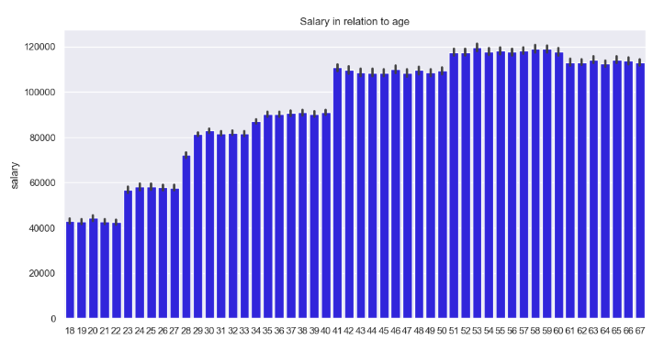
Salary & Age
The older the worker gets the higher their salary
The reason will be explained as we go thru the presentation

Slide 3
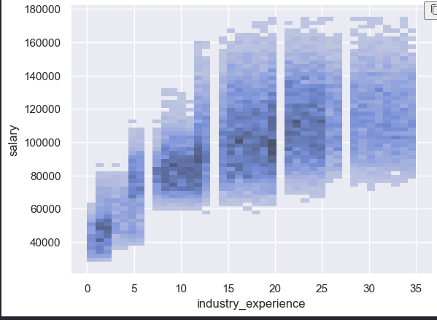
Salary & Industry Experience
We can see as the person has more industry experience, the higher their salary.

Slide 4
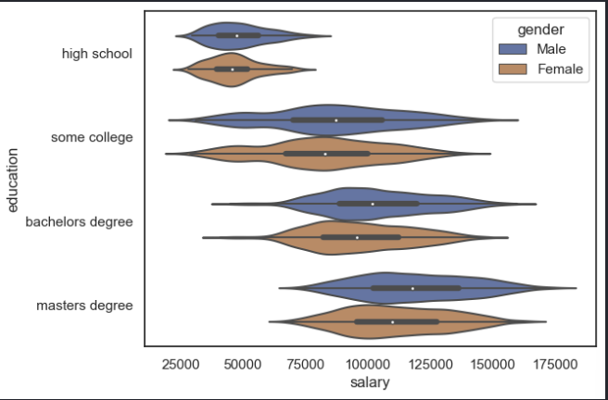
Salary & Education
The more educated the person is, the higher the salary

Slide 5
Takeaway
AGE
Industry Experience
Education
As worker ages, their education level & industry experience get increased, resulting in a higher average salary
Through the data we can see that the higher the industry y level for a worker, the higher they get compensated
As we saw in the graph, the more educated the worker is, the more they are compensated

